Slide 1
Executor Node1
Executor Node2
RDD
RAM (16GB, Avail: 12GB)
RAM (16GB, Avail: 12GB)
Storage Service Call (S3/GCS/Azure BLOB)
Total Size – 200GB
100GB
100GB
Default Size for partitioning – 128MB

Slide 2
SparkContext
3
Executor Node
SparkContext
(user 1)
Multiple end user appl
2
Driver Program
Master Node (YARN)
Name Node (HDFS)
PySpark Code
< by user 1 >
1
Application Master
4
Executor Node
PySpark Code
<>
PySpark Code
< by user 2 >
Executor Node
PySpark Code
<>
5
spark.driver.allowMultipleContexts = true

Slide 3
SparkSession
Executor Node
Multiple end user appl
SparkSession 1
YARN Master Node
PySpark Code
< by user 1 >
Application Master
SparkSession 2
SparkContext
SparkSession 3
Driver Program

Slide 4
Shuffling - groupByKey
10, Honda
10, Suzuki
10, Honda
20, Kia
20, Ford
30, Hyundai
10, Honda
20, Chevy
20, Mustang
30, Toyota
30, Lexus
30, Acura
30, Infinity
20, Nexus
20, Lexus
20, Mahindra
40, Tata
40, JLR
40, Tesla
20, Force
10, Tata
10, Honda
10, Suzuki
10, Honda
10, Honda
10, Tata
20, Kia
20, Ford
20, Chevvy
20, Mustang
20, Nexus
20, Lexus
20, Mahinda
20, Force
30, Hyundai
30, Toyota
30, Lexus
30, Acura
30, Infinity
40, Tata
40, JLR
40, Tesla
10, (Honda, Suzuki, Honda, Honda, Tata)
20, (Kia, Ford, Chevvy, Mustang, Nexus, Lexus, Mahindra, Ford)
30, (Hyundai, Toyota, Lexus, Acura, Infinity)
40, (Tata, JLR, Tesla)

Slide 5
Shuffling - reduceByKey
10, Honda
10, Suzuki
10, Honda
20, Kia
20, Ford
30, Hyundai
10, Honda
20, Chevy
20, Mustang
30, Toyota
30, Lexus
30, Acura
30, Infinity
20, Nexus
20, Lexus
20, Mahindra
40, Tata
40, JLR
40, Tesla
20, Force
10, Tata
10, (Honda, Suzuki, Honda)
20, (Kia, Ford)
30, Hyundai
10, (Honda)
20, (Chevy, Mustang)
30, (Toyota, Lexus)
20, (Nexus, Lexus, Mahindra)
30, (Acura, Infinity)
40, (Tata, JLR, Tesla)
20, (Ford)
10, (Tata)
10, Honda
10, Suzuki
10, Honda
10, Honda
10, Tata
20, Kia
20, Ford
20, Chevvy
20, Mustang
20, Nexus
20, Lexus
20, Mahinda
20, Force
30, Hyundai
30, Toyota
30, Lexus
30, Acura
30, Infinity
40, Tata
40, JLR
40, Tesla

Slide 6
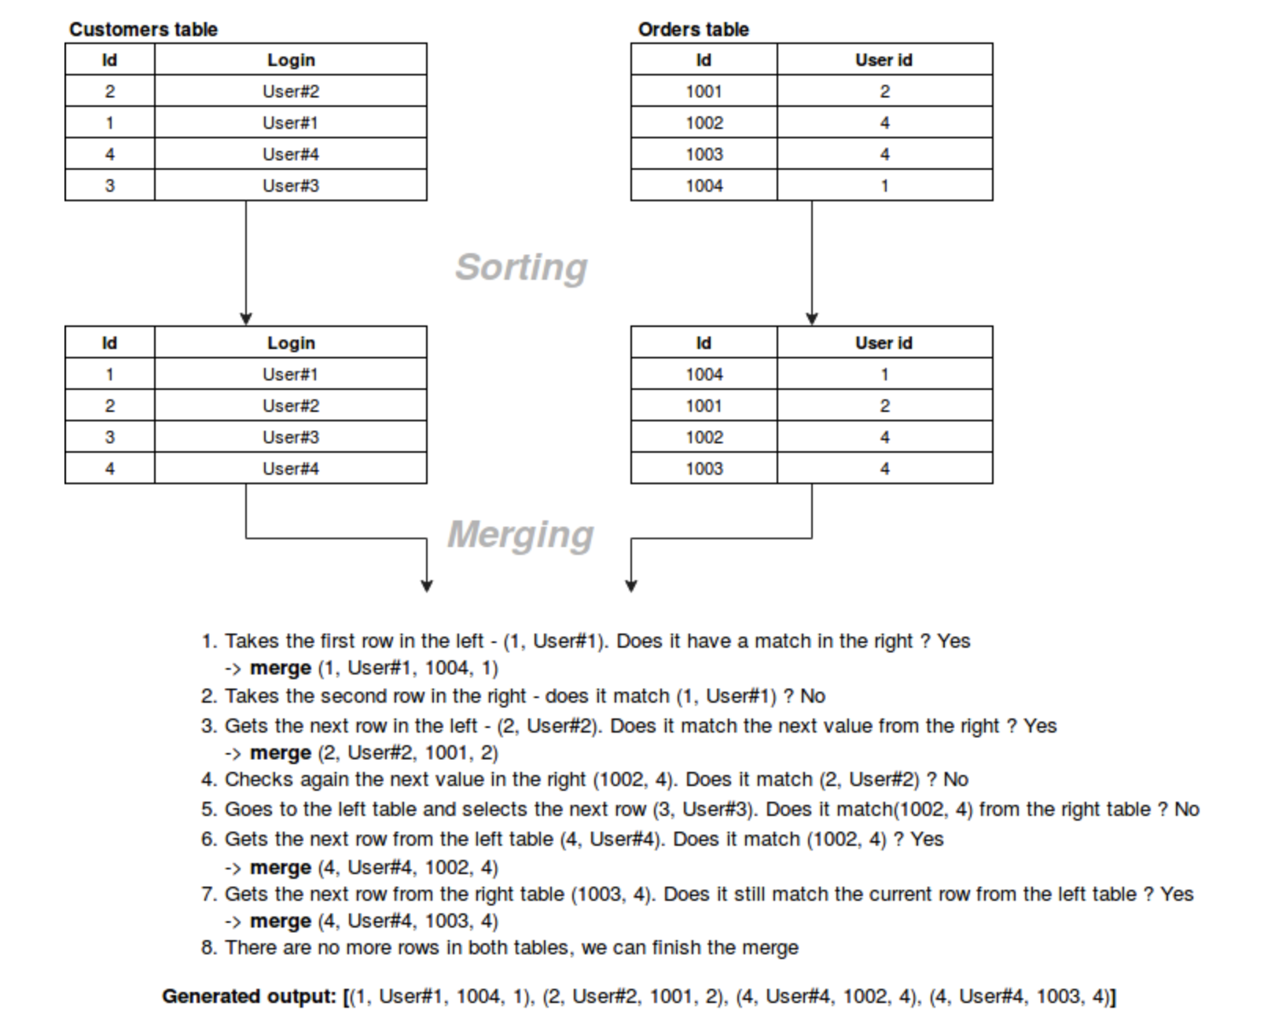
Joins – Sort Merge Join
Principle: Sort data before joining.
spark.sql.join.preferSortMergeJoin

Slide 7
Joins – Shuffle Hash Join
DF 1
DF 2
Shuffle
Join
Shuffle
Join Key
Join Key
10
Partition 0
Partition 1
Partition 2
Partition 0
40
20
Partition 1
Partition 0
Partition 3
Partition 1
30
30
Partition 2
Partition 3
Partition 0
Partition 2
20
40
Partition 3
Partition 2
Partition 1
Partition 3
10
Shuffle
Each shuffle will spawn a new stage – 3 stages
New DataFrame

Slide 8
Joins – Broadcast Hash Join
Condition for Broadcasting one of the DataFrames – it has to be SMALL
Join
Broadcast
Spark Driver
Partition 1
DataFrame2
Partition 0
DataFrame2
DF 1
DataFrame 2
Partition 3
DataFrame2
Partition 2
DataFrame2
spark.sql.autoBroadcastJoinThreshold
Default is less Than 10MB
2 stages
Shuffle
New DataFrame

Slide 9
Lets see how Catalyst Optimizer works
select a1, sum(b1)
from A join B
on A.key = B.key
where b1 > 2208
group by a1
dfa = df.select(‘a1’, ‘key’)
dfb = df.select(‘b1’, ‘key’).where(col(‘b1’) > 2208)
join_data = dfa.join(dfb, [‘key’], ‘inner’).drop(‘key’) ➔ a1, b1, key
agg_data = join_data.groupBy(‘a1’).agg(sum(‘b1’)).show()
Joined1 = dfA.select(‘a1’, ‘key’).join(dfB.select((col(‘b1’) > 2208), ‘key’), [“key”], ‘inner’)
Joined2 = Joined1.groupBy(‘a1’).agg(sum(‘b1’)).show()

Slide 10
Execution Plan – Catalyst Optimizer
select a1, sum(b1)
from A join B
on A.key = B.key
where b1 > 2208
group by a1
Catalog
Spark SQL
Unresolved Logical Plan
Resolved Logical Plan
Optimized Logical Plan
Physical Plan
Cost Model
Final
Physical Plan
RDDs
DataFrame
Scan B
Scan A
Filter
Tungsten Execution
Scan B
BroadcastExchange
Scan A
BroadcastHashJoin
Filter
Jobs
HashAggregate
Join
Stages
ShuffleExchange
Aggregate
Tasks
HashAggregate

Slide 11
Jobs
Job 1
Stage 1
Job 2
Scan B
Stage 1
Filter
Scan A
BroadcastHashJoin
BroadcastExchange
HashAggregate
ShuffleExchange
Stage 2
HashAggregate

Slide 12
Executor Node
SparkContext
(user 1)
Driver Program
Client (for Spark)
Master Node (YARN)
Name Node (HDFS)
Client (for Spark)
Remote Node
spark-submit
Resource Manager
Executor Node
PySpark Code
<>
spark-submit
Executor Node
PySpark Code
<>

